Slide 1




SUBJECT: PROGRAMMING IN JAVA
SEMESTER: 3rd Semester BCA
1
JAIN UNIVERSITY BCA

Slide 2
OBJECTS AND CLASSES
1
JAIN UNIVERSITY BCA

Slide 3
WHAT IS AN ARRAY OF OBJECTS?
What Is An Array Of Objects?
Java Array Of Objects, as defined by its name, stores an array of objects.
The array elements store the location of the reference variables of the object.
Syntax:
Class obj[]= new Class[array_length]
Class ObjectArray
{
public static void main(String args[])
{
Account obj[] = new Account[2] ;
//obj[0] = new Account();
obj[1] = new Account();
obj[0].setData(1,2);
obj[1].setData(3,4);
System.out.println("For Array Element 0");
obj[0].showData();
System.out.println("For Array Element 1");

Slide 4
obj[0].showData();
System.out.println("For Array Element 1");
obj[1].showData();
}
} class Account
{ int a; int b;
public void setData(int c,int d)
{
a=c; b=d;
}
public void showData()
{ System.out.println("Value of a ="+a);
System.out.println("Value of b ="+b);
}
}

Slide 5
Output:
For Array Element 0
Value of a =1
Value of b =2
For Array Element 1
Value of a =3
Value of b =4

Slide 6
Wrapper classes in Java
The wrapper class in Java provides the mechanism to convert primitive into object and object into primitive.
Primitive Type | Wrapper class
boolean | Boolean
char | Character
byte | Byte
short | Short
int | Integer
long | Long
float | Float
double | Double

Slide 7
Autoboxing
The automatic conversion of primitive data type into its corresponding wrapper class is known as autoboxing,
Wrapper class Example: Primitive to Wrapper
//Java program to convert primitive into objects
public class WrapperExample3{
public static void main(String args[]){
byte b=10;
short s=20;
int i=30;
long l=40;
float f=50.0F;
double d=60.0D;
char c='a';
boolean b2=true;

Slide 8
//Autoboxing: Converting primitives into objects
Byte byteobj=b;
Short shortobj=s;
Integer intobj=i;
Long longobj=l;
Float floatobj=f;
Double doubleobj=d;
Character charobj=c;
Boolean boolobj=b2;
//Unboxing: Converting Objects to Primitives
byte bytevalue=byteobj;
short shortvalue=shortobj;
int intvalue=intobj;
long longvalue=longobj;
float floatvalue=floatobj;
double doublevalue=doubleobj;
char charvalue=charobj;
boolean boolvalue=boolobj

Slide 9
In object-oriented programming, a dependency between classes occurs when one class relies on another class, typically through method parameters or local variables.;
Example: Dependency between Library and Book classes
In this example, the Library class has a method that depends on the Book class to perform a book checkout operation.
Association in object-oriented programming represents a relationship between two or more classes. It is a way of connecting classes and can be classified into various types, such as one-to-one, one-to-many, and many-to-many associations.
Example: Association between Student and Course classes
Consider two classes: Student and Course. A student can be associated with multiple courses, and a course can have multiple students. This is an example of a many-to-many association.
Aggregation in Java is a type of class relationship where one class contains an object of another class,. Aggregation represents a "has-a" relationship
EXAMPLE of aggregation between a University and a Department class:
java

Slide 10
What is Package in Java?
PACKAGE in Java is a collection of classes, sub-packages, and interfaces. It helps organize your classes into a folder structure and make it easy to locate and use them.
Advantages:
It helps improve code reusability.
classes with the same name cannot appear in the same package, they can appear in different packages.
Syntax:-
package nameOfPackage;

Slide 11
Package in Java is a mechanism to encapsulate a group of classes, sub packages and interfaces.
PACKAGE in Java is a collection of classes, sub-packages, and interfaces. It helps organize your classes into a folder structure and make it easy to locate and use them.
Advantages:
It helps improve code reusability.
classes with the same name cannot appear in the same package, they can appear in different packages.
Syntax:-
package nameOfPackage;

Slide 12
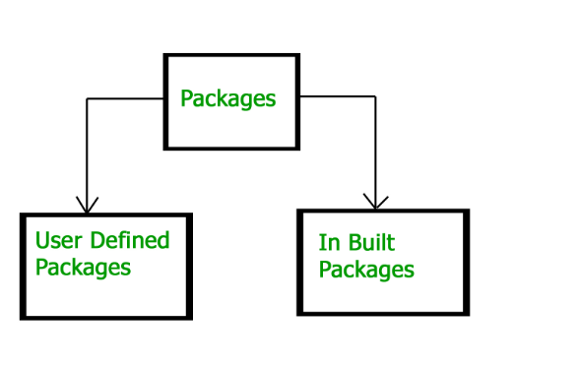
Package names and directory structure are closely related.
For example if a package name is college.staff.cse,
staff and cse such that cse is present in staff and staff is present inside college.
Packages that are inside another package are the subpackages.
import java.util.*;
util is a subpackage created inside java package
.
Accessing classes inside a package
Consider following two statements :
// import the Vector class from util package. import java.util.vector;
// import all the classes from util package import java.util.*;
Types of packages:

Slide 13
Built-in Packages
java.lang: classed which defines primitive data types, math operations).
java.io: Contains classed for supporting input / output operations.
java.applet: Contains classes for creating Applets
java.awt: Contain classes for implementing the components for graphical user interfaces (like button , ;menus etc).
User-defined packages These are the packages that are defined by the user.

Slide 14
To create a package, use the package keyword:
file name:MyPackageClass.java
package mypack;
class MyPackageClass
{
public static void main(String[] args)
{
System.out.println("This is my package!");
}
}

Slide 15
Save the file as MyPackageClass.java, and compile it:
C:\Users\Your Name>javac MyPackageClass.java
Then compile the package:
C:\Users\Your Name>javac -d . MyPackageClass.java
The -d keyword specifies the destination for where to save the class file. You can use any directory name, like c:/user (windows),
When we compiled the package in the example above, a new folder was created, called "mypack".
To run the MyPackageClass.java file, write the following:
C:\Users\Your Name>java mypack.MyPackageClass
The output will be:
This is my package!

Slide 16
We'll create a package named myPackage with two classes: MainClass and MyClass.
package myPackage;
public class MainClass
{
public static void main(String[] args)
{
System.out.println("Hello from MainClass!");
// Creating an instance of MyClass
MyClass myObject = new MyClass();
myObject.displayMessage();
}
}

Slide 17
package myPackage;myPackage myPackage
public class MyClass
{
public void displayMessage()
{
System.out.println("Hello from MyClass!");
}
}
Open a terminal or command prompt, navigate to the myproject directory, and compile the code:
javac src/com/example/javac MainClass.java
This will compile both MainClass and MyClass.
Run the compiled program:
java myPackage.MainClass
You should see the output:
Hello from MainClass!
Hello from MyClass!

